Slide 1
Alex Fat Treg Expression Analysis
rahuldhodapkar

Slide 2
Processing Steps
Merge data from .matrix expression files
Remove outliers by:
Mitochondrial expression > 5%
>2500 or <200 genes
ERCC >1%
Non-Treg cells (one section of adipocytes)
Scale data by
Mitochondrial expression
ERCC expression
RNA transcript count per cell
Batch (date of SmartSeq2 library prep)

Slide 3
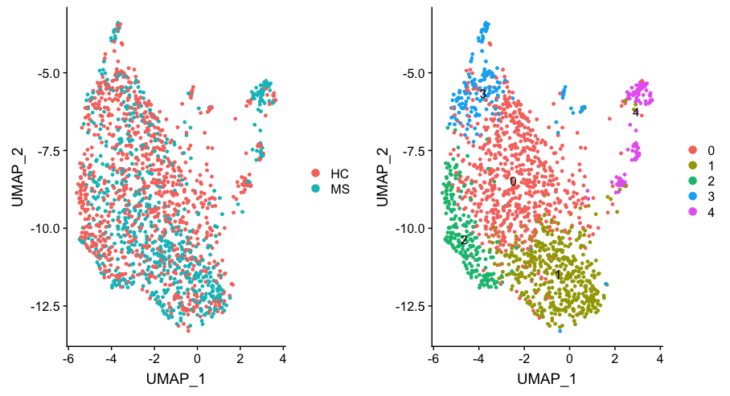
Combined Treg data shows little separation

Slide 4
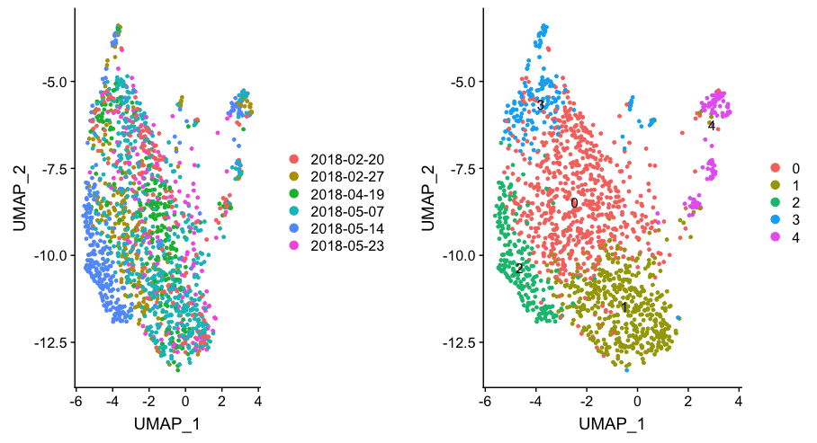
Despite regression, batch effects are present

Slide 5
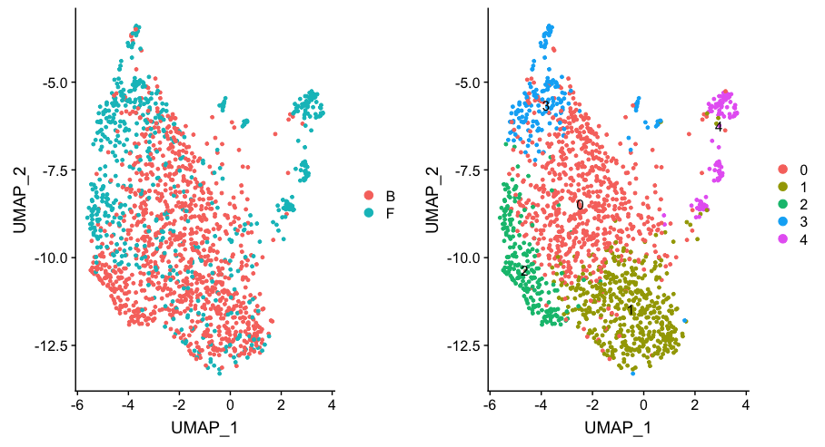
Source tissue is a strong determinant of clustering

Slide 6
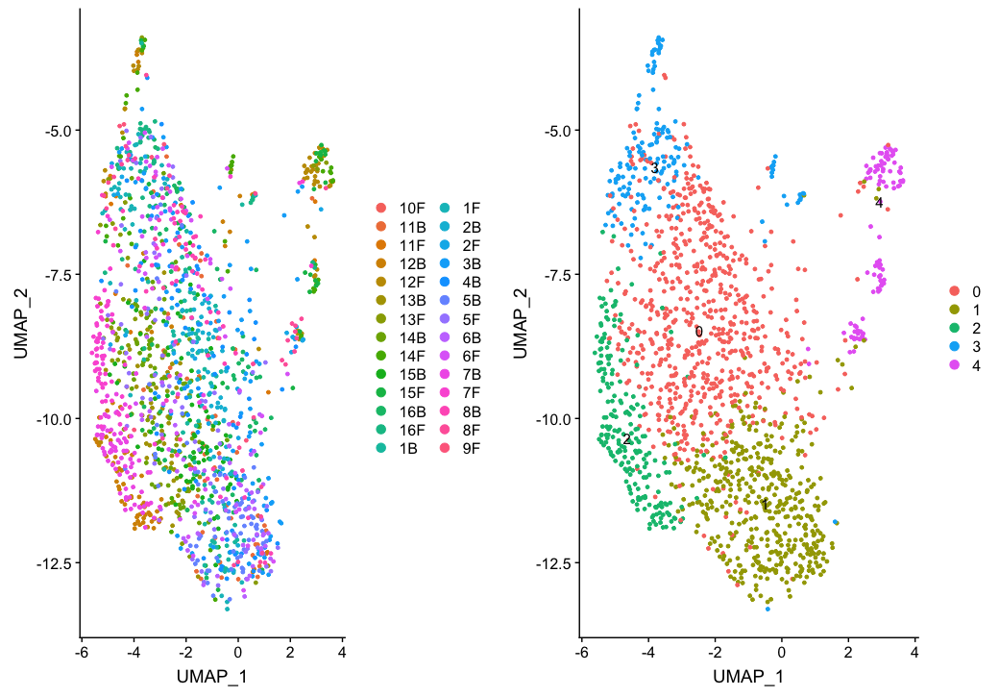
Some per-sample clustering observed, but mostly well-mixed

Slide 7
Separation into Fat and Blood
Because of observed difference in clustering between fat and blood, analysis was performed for each separately.
Fat Tregs showed some significant differences between HC and MS groups, but blood Tregs did not.

Slide 8
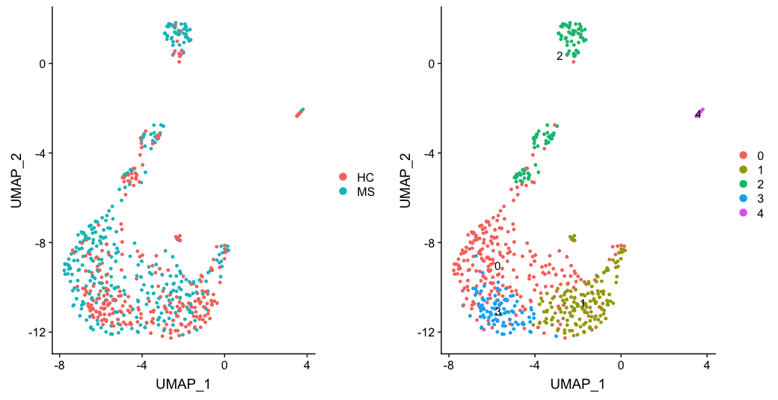
Fat group

Slide 9
Top DEGs for Fat Tregs
Gene | p_val | Avg_logFC | PCT.HC | PCT.MS | P_val_adj
ENSG00000128016-ZFP36 | 3.091889e-22 | 1.3120483 | 0.695 | 0.337 | 1.789122e-17
ENSG00000196154-S100A4 | 4.578416e-15 | 0.5808352 | 0.684 | 0.396 | 2.649300e-10
ENSG00000179820-MYADM | 1.076060e-13 | 0.8555008 | 0.518 | 0.229 | 6.226620e-09
ENSG00000153234-NR4A2 | 9.067877e-13 | 0.7991735 | 0.493 | 0.223 | 5.247127e-08
ENSG00000271204-RP11-138A9.1 | 1.900796e-11 | 0.7056779 | 0.489 | 0.235 | 1.099896e-06
ENSG00000160789-LMNA | 4.443978e-11 | 0.8672032 | 0.599 | 0.319 | 2.571508e-06
ENSG00000167615-LENG8 | 7.811966e-11 | 0.5490473 | 0.603 | 0.334 | 4.520394e-06
ENSG00000092199-HNRNPC | 9.541951e-11 | 0.4522481 | 0.688 | 0.409 | 5.521450e-06
Notes:
ZFP36 <- Tristetraproline (TTP)
Inhibitor of TNF-alpha

Slide 10
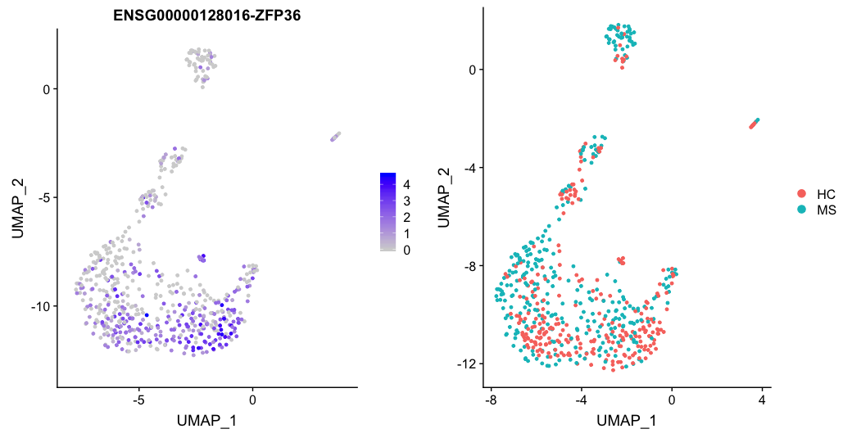
ZFP36 (Tristetraprolin)

Slide 11
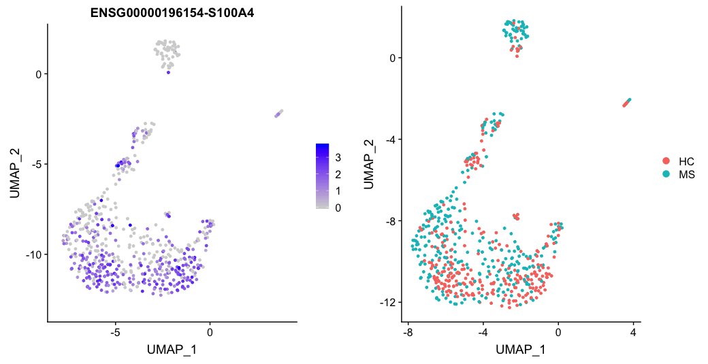
S100A4

Slide 12
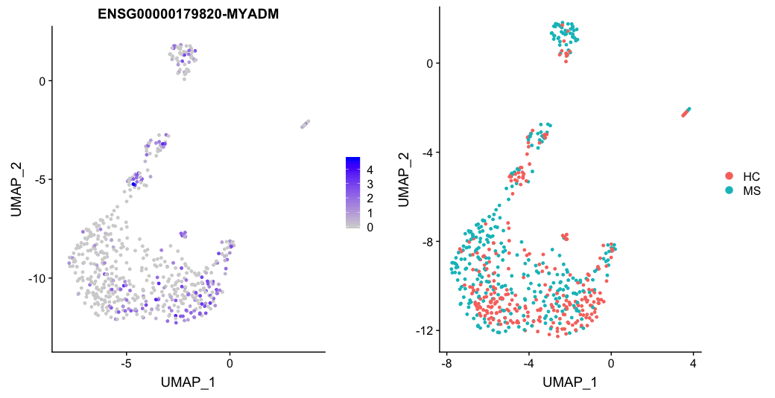
MYADM

Slide 13
FOS

Slide 14
IFNG

Slide 15
CCR7

Slide 16
Treg markers
Notes:
CD127 is fairly high given that these cells are supposed to be Tregs

Slide 17
Blood does not group well to MS / HC

Slide 18
Treg Markers

